Slide 1
Strategies for Query Processing

Slide 2
Introduction
DBMS techniques to process a query
Scanner identifies query tokens
Parser checks the query syntax
Validation checks all attribute and relation names
Query tree (or query graph) created
Execution strategy or query plan devised
Query optimization
Planning a good execution strategy

Slide 3
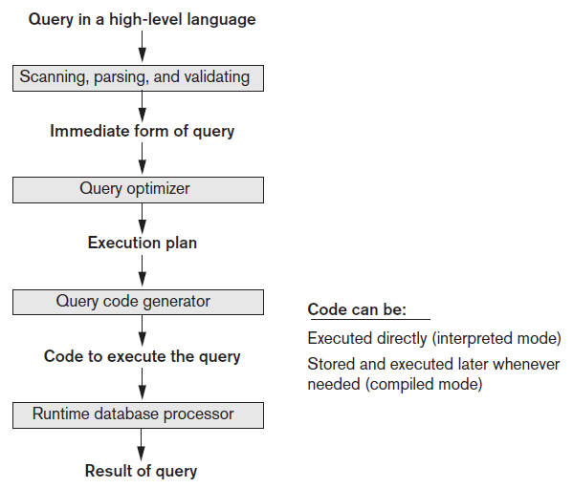
Query Processing
Figure 18.1 Typical steps when processing a high-level query

Slide 4
18.1 Translating SQL Queries into Relational Algebra and Other Operators
SQL
Query language used in most RDBMSs
Query decomposed into query blocks
Basic units that can be translated into the algebraic operators
Contains single SELECT-FROM-WHERE expression
May contain GROUP BY and HAVING clauses

Slide 5



Translating SQL Queries (cont’d.)
Example:
Inner block
Outer block

Slide 6


Translating SQL Queries (cont’d.)
Example (cont’d.)
Inner block translated into:
Outer block translated into:
Query optimizer chooses execution plan for each query block

Slide 7
Additional Operators Semi-Join and Anti-Join
Semi-join
Generally used for unnesting EXISTS, IN, and ANY subqueries
Syntax: T1 ⋉_{X=Y} T2 OR T1.x S= T2.y
T1 is the left table and T2 is the right table of the semi-join
A row of T1 is returned as soon as T1.X finds a match with any value of T2.Y without searching for further matches

Slide 8
Semi-Join Example
STUDENT |  |  |  | MEMBER |  |  |  | Semi join
RollNo | Name | Sex |  | Society | RollNo | role |  | (STUDENT ⋉ MEMBER)
101 | Isbah | F |  | Sports | 101 | member |  | RollNo | Name | Sex
102 | Izaan | M |  | Sports | 102 | member |  | 101 | Isbah | F
103 | Tahreem | F |  | Sports | 999 | Gen Sec |  | 102 | Izaan | M
104 | Khadija | F |  | Creative | 102 | member |  | 103 | Tahreem | F
111 | Alia | F |  | Creative | 103 | VP |  | 999 | Ismail | M
888 | Fatima | F |  | ACM | 102 | member
999 | Ismail | M
SQL: SELECT * FROM student
WHERE EXISTS (SELECT * FROM member
WHERE student.rollno=member.rollno

Slide 9
Inner-Join Example
STUDENT |  |  |  | MEMBER
RollNo | Name | Sex |  | Society | RollNo | role
101 | Isbah | F |  | Sports | 101 | member
102 | Izaan | M |  | Sports | 102 | member
103 | Tahreem | F |  | Sports | 999 | Gen Sec
104 | Khadija | F |  | Creative | 102 | member
111 | Alia | F |  | Creative | 103 | VP
888 | Fatima | F |  | ACM | 102 | member
999 | Ismail | M
(Inner) join
STUDENT ⋈ MEMBER
RollNo | Name | Sex | Society | rollNo | Role
101 | Isbah | F | Sports | 101 | member
102 | Izaan | M | Creative | 102 | member
102 | Izaan | M | Sports | 999 | Gen Sec
102 | Izaan | M | ACM | 102 | member
103 | Tahreem | F | Creative | 103 | VP
999 | Ismail | M | Sports | 999 | Gen Sec
SQL:
SELECT *
FROM student JOIN member
ON student.rollno=member.rollno

Slide 10
Additional Operators Semi-Join and Anti-Join (cont’d.)
Anti-join
Used for unnesting NOT EXISTS, NOT IN, and ALL subqueries
Syntax: T1 ▷_{X=Y} T2 OR T1.x A= T2.y
T1 is the left table and T2 is the right table of the anti-join
A row of T1 is rejected as soon as T1.x finds a match with any value of T2.y
A row of T1 is returned only if T1.x does not match with any value of T2.y

Slide 11
Anti-Join Example
STUDENT |  |  |  | MEMBER |  |  |  | Anti join
RollNo | Name | Sex |  | Society | RollNo | role |  | (STUDENT ▷ MEMBER)
101 | Isbah | F |  | Sports | 101 | member |  | RollNo | Name | Sex
102 | Izaan | M |  | Sports | 102 | member |  | 104 | Khadija | F
103 | Tahreem | F |  | Sports | 999 | Gen Sec |  | 111 | Alia | F
104 | Khadija | F |  | Creative | 102 | member |  | 888 | Fatima | F
111 | Alia | F |  | Creative | 103 | VP
888 | Fatima | F |  | ACM | 102 | member
999 | Ismail | M
SQL: SELECT * FROM student
WHERE NOT EXISTS (SELECT * FROM member
WHERE student.rollno=member.rollno

Slide 12
18.2 Algorithms for External Sorting
Sorting is an often-used algorithm in query processing
External sorting
Algorithms suitable for large files that do not fit entirely in main memory
Sort-merge strategy based on sorting smaller subfiles (runs) and merging the sorted runs
Requires buffer space in main memory
DBMS cache

Slide 13
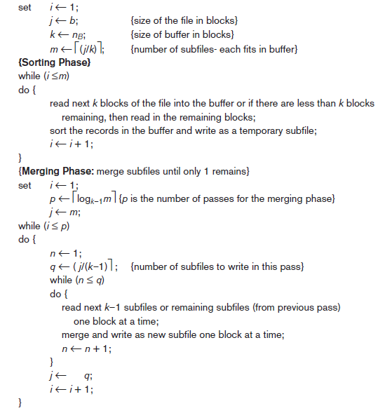
Figure 18.2 Outline of the sort-merge algorithm for external sorting

Slide 14
Algorithms for External Sorting (cont’d.)
Degree of merging
Number of sorted subfiles that can be merged in each merge step
Performance of the sort-merge algorithm
Number of disk block reads and writes before sorting is completed
The following formula approximates this cost:
(2 * b) + (2 * b * (log_{dM} b/k))

Slide 15
18.3 Algorithms for SELECT Operation
SELECT operation
Search operation to locate records in a disk file that satisfy a certain condition
File scan or index scan (if search involves an index)
Search methods for simple selection
S1: Linear search (brute force algorithm)
S2: Binary search
S3a: Using a primary index
S3b: Using a hash key

Slide 16
Algorithms for SELECT Operation (cont’d.)
Search methods for simple selection (cont’d.)
S4: Using a primary index to retrieve multiple records
S5: Using a clustering index to retrieve multiple records
S6: Using a secondary (B+ -tree) index on an equality comparison
S7a: Using a bitmap index
S7b: Using a functional index

Slide 17
Algorithms for SELECT Operation (cont’d.)
Search methods for conjunctive (logical AND) selection
Using an individual index
Using a composite index
Intersection of record pointers
Disjunctive (logical OR) selection
Harder to process and optimize

Slide 18
Algorithms for SELECT Operation (cont’d.)
Selectivity
Ratio of the number of records (tuples) that satisfy the condition to the total number of records (tuples) in the file
Number between zero (no records satisfy condition) and one (all records satisfy condition)
Query optimizer receives input from system catalog to estimate selectivity

Slide 19
18.4 Implementing the JOIN Operation
JOIN operation
One of the most time consuming in query processing
EQUIJOIN (NATURAL JOIN)
Two-way or multiway joins
Methods for implementing joins
J1: Nested-loop join (nested-block join)
J2: Index-based nested-loop join
J3: Sort-merge join
J4: Partition-hash join

Slide 20
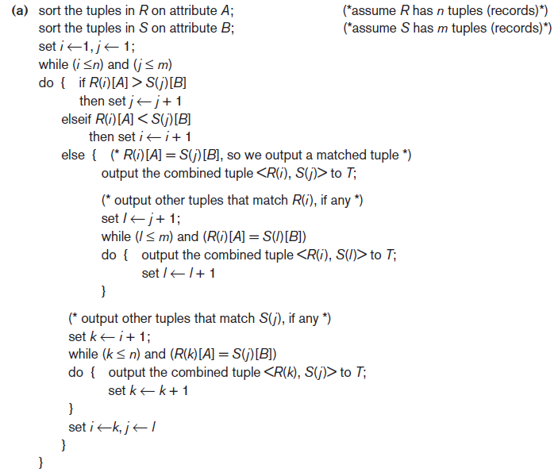

Implementing the JOIN Operation (cont’d.)
Figure 18.3 Implementing JOIN, PROJECT, UNION, INTERSECTION, and SET DIFFERENCE by using sort-merge, where R has n tuples and S has m tuples. (a) Implementing the operation

Slide 21
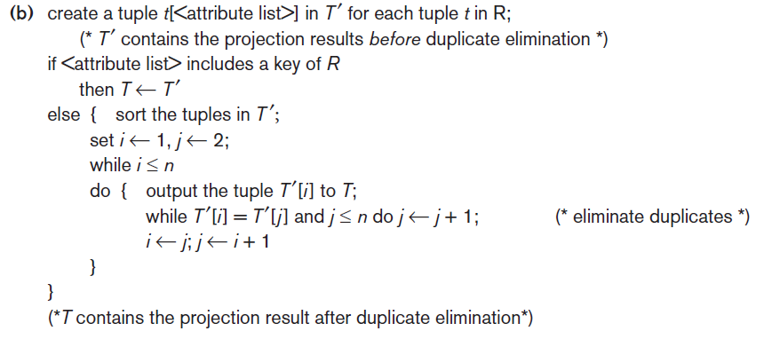

Implementing the JOIN Operation (cont’d.)
Figure 18.3 (cont’d.) Implementing JOIN, PROJECT, UNION, INTERSECTION, and SET DIFFERENCE by using sort-merge, where R has n tuples and S has m tuples. (b) Implementing the operation

Slide 22
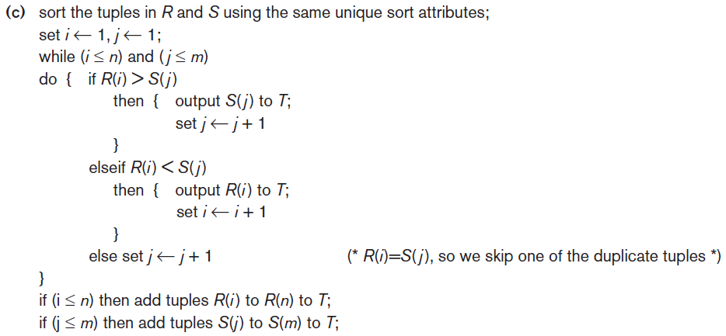
Implementing the JOIN Operation (cont’d.)
Figure 18.3 (cont’d.) Implementing JOIN, PROJECT, UNION, INTERSECTION, and SET DIFFERENCE by using sort-merge, where R has n tuples and S has m tuples. (c) Implementing the operation

Slide 23
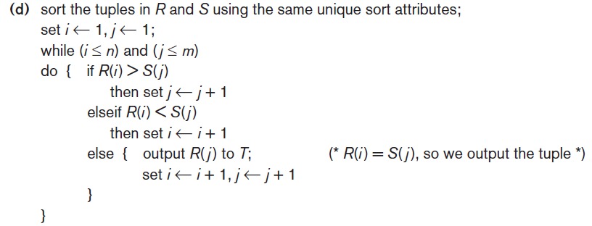
Implementing the JOIN Operation (cont’d.)
Figure 18.3 (cont’d.) Implementing JOIN, PROJECT, UNION, INTERSECTION, and SET DIFFERENCE by using sort-merge, where R has n tuples and S has m tuples. (d) Implementing the operation

Slide 24
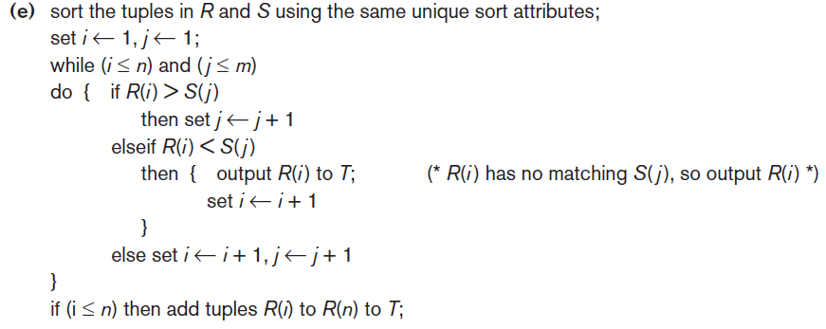
Implementing the JOIN Operation (cont’d.)
Figure 18.3 (cont’d.) Implementing JOIN, PROJECT, UNION, INTERSECTION, and SET DIFFERENCE by using sort-merge, where R has n tuples and S has m tuples. (e) Implementing the operation

Slide 25
Implementing the JOIN Operation (cont’d.)
Available buffer space has important effect on some JOIN algorithms
Nested-loop approach
Read as many blocks as possible at a time into memory from the file whose records are used for the outer loop
Choice of outer-loop file affect performance of NLJ
Advantageous to use the file with fewer blocks as the outer-loop file

Slide 26
Example: EMPLOYEE ⋈_{Dno=Dnumber} DEPARTMENT
Assume that the number of buffers available in main memory for implementing the join is k= n_{b} = 7 blocks. The DEPARTMENT file consist of r_{D} = 50 record stored in b_{D} = 10 disk blocks and that the EMPLOYEE file consists of r_{E} = 6000 record stored in b_{E} = 2000 disk blocks.
Total number of block accessed for outer-loop file = b_{E}
No of times (n_{b} - 2) blocks of outer file are loaded into mem.= ⌈b_{E} /(n_{b} - 2)⌉
Total number of block accessed for inner-loop file = ⌈b_{E} /(n_{b} - 2)⌉ * b_{D}
Hence, total no of block accesses (If EMPLOYEE records in outer-loop):
b_{E} + (⌈b_{E} /(n_{b} - 2)⌉ * b_{D}) = 2000 + ( ⌈ 2000/5 ⌉ * 10) = 6000 block accesses
If we use DEPARTMENT records in the outer-loop, by symmetry:
b_{D} + (⌈b_{D} /(n_{b} - 2)⌉ * b_{E}) = 10 + ( ⌈ 10/5 ⌉ * 2000) = 4010 block accesses
Additional b_{RES} (blocks of result file of join operation) should be added.

Slide 27
Implementing the JOIN Operation (cont’d.)
Join selection factor
Fraction of records in one file that will be joined with records in another file
Depends on the particular equijoin condition with another file
Affects join performance

Slide 28
Example: DEPARTMENT ⋈_{Mgr_ssn=Ssn} EMPLOYEE
Suppose that secondary indexes exist on both the attributes
Ssn of employee and Mgr_ssn of department,
with the number of index levels X_{Ssn} = 4 and X_{Mgr_ssn} = 2, respectively.
Option1: Retrieve each employee record and then uses the index on Mgr_ssn of department to find a matching department record.
The no of block accesses for this case:
b_{E} + (r_{E} * (X_{Mgr_ssn} + 1)) = 2000 + (6000 * (2 + 1)) = 20,000 block accesses
(join selection factor of employee is 50/6000, or 0.8%)
Option2: Retrieve each department record and then uses the index on Ssn of employee to find a matching manager employee record.
The no of block accesses for this case:
b_{D} + (r_{D} * (X_{Ssn} + 1)) = 10 + (50 * (4 + 1)) = 260 block accesses
(join selection factor of department is 50/50, or 100%)

Slide 29
Implementing the JOIN Operation (cont’d.)
Partition-hash join
Each file is partitioned into M partitions using the same partitioning hash function on the join attributes
Each pair of corresponding partitions is joined
Hybrid hash-join
Variation of partition hash-join
Joining phase for one of the partitions is included in the partition
Goal: join as many records during the partitioning phase to save cost of storing records on disk and then rereading during the joining phase

Slide 30
18.5 Algorithms for PROJECT and Set Operations
PROJECT operation
After projecting R on only the columns in the list of attributes, any duplicates are removed by treating the result strictly as a set of tuples
Default for SQL queries
No elimination of duplicates from the query result
Duplicates eliminated only if the keyword DISTINCT is included

Slide 31
Algorithms for PROJECT and Set Operations (cont’d.)
Set operations
UNION
INTERSECTION
SET DIFFERENCE
CARTESIAN PRODUCT
Set operations sometimes expensive to implement
Sort-merge technique
Hashing

Slide 32
Algorithms for PROJECT and Set Operations (cont’d.)
Use of anti-join for SET DIFFERENCE
EXCEPT or MINUS in SQL
Example: Find which departments have no employees
becomes
RA: DEPARTMENT ▷_{Dnumber=Dno} EMPLOYEE
SQL: SELECT * FROM department, employee
WHERE department.Dnumber A= employee.Dno
(Non-standard notation for anti-join)

Slide 33

18.6 Implementing Aggregate Operations and Different Types of JOINs
Aggregate operators
MIN, MAX, COUNT, AVERAGE, SUM
Can be computed by a table scan or using an appropriate index
Example:
If an (ascending) B+ -tree index on Salary exists:
Optimizer can use the Salary index to search for the largest Salary value
Follow the rightmost pointer in each index node from the root to the rightmost leaf

Slide 34
Implementing Aggregate Operations and Different Types of JOINs (cont’d.)
AVERAGE or SUM
Index can be used if it is a dense index
Computation applied to the values in the index
Nondense index can be used if actual number of records associated with each index value is stored in each index entry
COUNT
Number of values can be computed from the index

Slide 35
Implementing Aggregate Operations and Different Types of JOINs (cont’d.)
Standard JOIN (called INNER JOIN in SQL)
Variations of joins
Outer join
Left, right, and full
Example:
Semi-Join
Anti-Join
Non-Equi-Join

Slide 36
18.7 Combining Operations Using Pipelining
SQL query translated into relational algebra expression
Sequence of relational operations
Materialized evaluation
Creating, storing, and passing temporary results
General query goal: minimize the number of temporary files
Pipelining or stream-based processing
Combines several operations into one
Avoids writing temporary files

Slide 37
Combining Operations Using Pipelining (cont’d.)
Pipelined evaluation benefits
Avoiding cost and time delay associated with writing intermediate results to disk
Being able to start generating results as quickly as possible
Iterator
Operation implemented in such a way that it outputs one tuple at a time
Many iterators may be active at one time

Slide 38
Combining Operations Using Pipelining (cont’d.)
Iterator interface methods
Open()
Get_Next()
Close()
Some physical operators may not lend themselves to the iterator interface concept
Pipelining not supported
Iterator concept can also be applied to access methods

Slide 39
18.8 Parallel Algorithms for Query Processing
Parallel database architecture approaches
Shared-memory architecture
Multiple processors can access common main memory region
Shared-disk architecture
Every processor has its own memory
Machines have access to all disks
Shared-nothing architecture
Each processor has own memory and disk storage
Most commonly used in parallel database systems

Slide 40
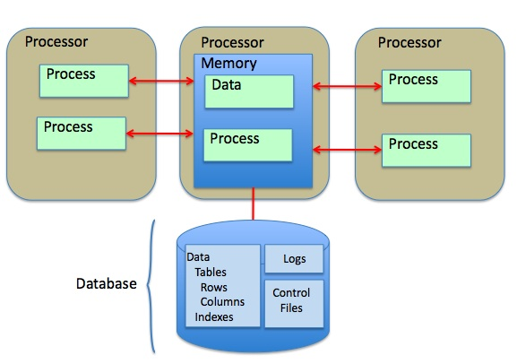
Shared-memory architecture Multiple processors can access common main memory region

Slide 41
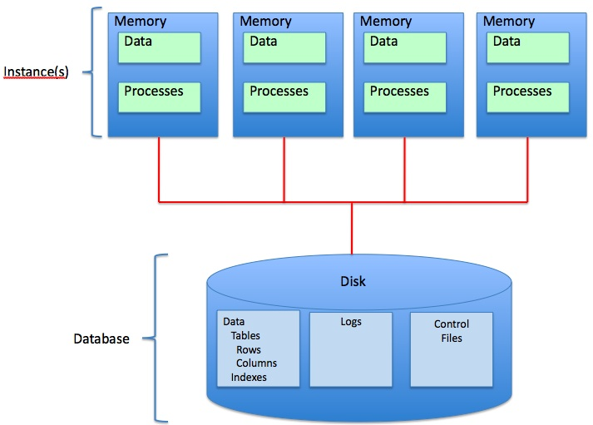
Shared-disk architecture Every processor has its own memory and Machines have access to all disks

Slide 42
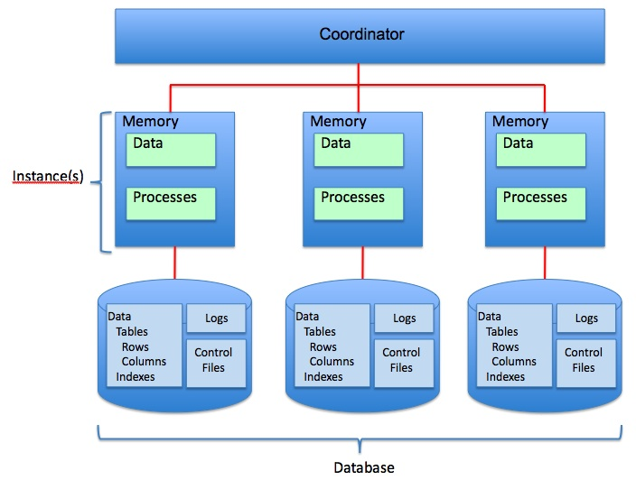
Shared-nothing architecture Each processor has own memory and disk storage

Slide 43
Parallel Algorithms for Query Processing (cont’d.)
Linear speed-up
Linear reduction in time taken for operations
Linear scale-up
Constant sustained performance by increasing the number of processors and disks

Slide 44
Parallel Algorithms for Query Processing (cont’d.)
Operator-level parallelism
Horizontal partitioning
Round-robin partitioning
Range partitioning
Hash partitioning
Sorting
If data has been range-partitioned on an attribute:
Each partition can be sorted separately in parallel
Results concatenated
Reduces sorting time

Slide 45
Parallel Algorithms for Query Processing (cont’d.)
Selection
If condition is an equality condition on an attribute used for range partitioning:
Perform selection only on partition to which the value belongs
Projection without duplicate elimination
Perform operation in parallel as data is read
Duplicate elimination
Sort tuples and discard duplicates

Slide 46
Parallel Algorithms for Query Processing (cont’d.)
Parallel joins divide the join into n smaller joins
Perform smaller joins in parallel on n processors
Take a union of the result
Parallel join techniques
Equality-based partitioned join
Inequality join with partitioning and replication
Parallel partitioned hash join

Slide 47
Parallel Algorithms for Query Processing (cont’d.)
Aggregation
Achieved by partitioning on the grouping attribute and then computing the aggregate function locally at each processor
Set operations
If argument relations are partitioned using the same hash function, they can be done in parallel on each processor

Slide 48
Parallel Algorithms for Query Processing (cont’d.)
Intraquery parallelism
Approaches
Use parallel algorithm for each operation, with appropriate partitioning of the data input to that operation
Execute independent operations in parallel
Interquery parallelism
Execution of multiple queries in parallel
Goal: scale up
Difficult to achieve on shared-disk or shared-nothing architectures

Slide 49
18.9 Summary
SQL queries translated into relational algebra
External sorting
Selection algorithms
Join operations
Combining operations to create pipelined execution
Parallel database system architectures

